Slide 1
Fabulous four formerly known as the top five

Slide 2
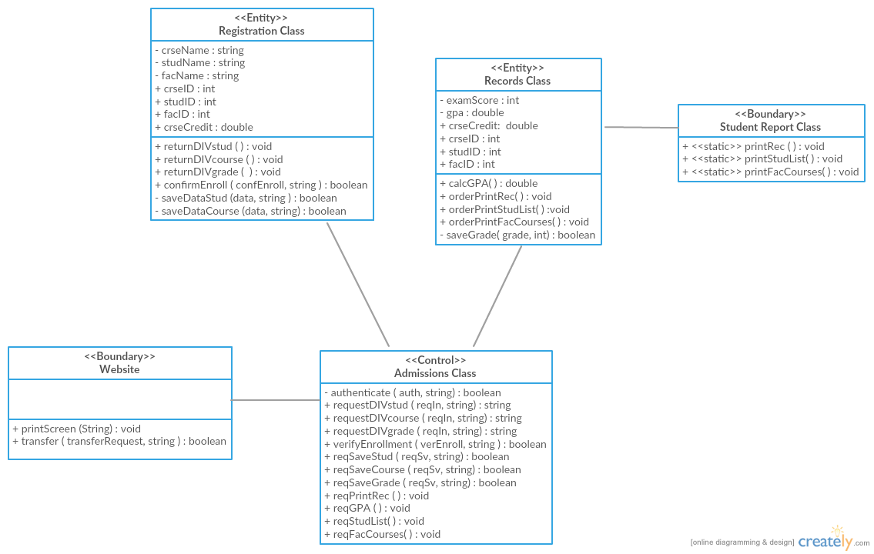
Class Diagrams

Slide 3
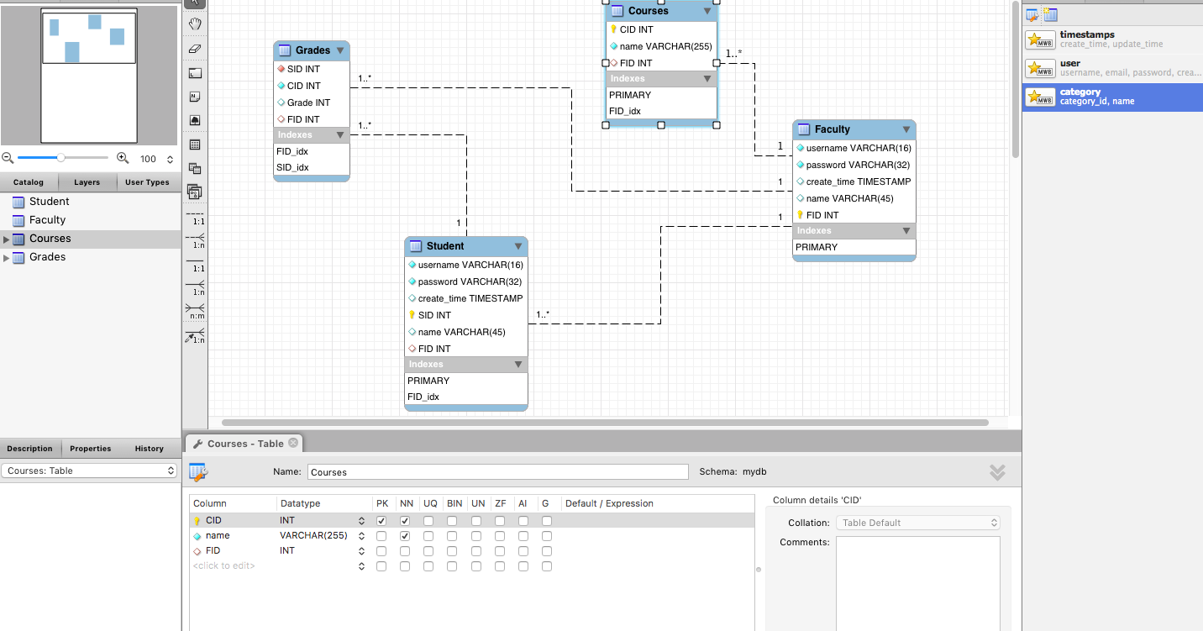
ER Diagram

Slide 4
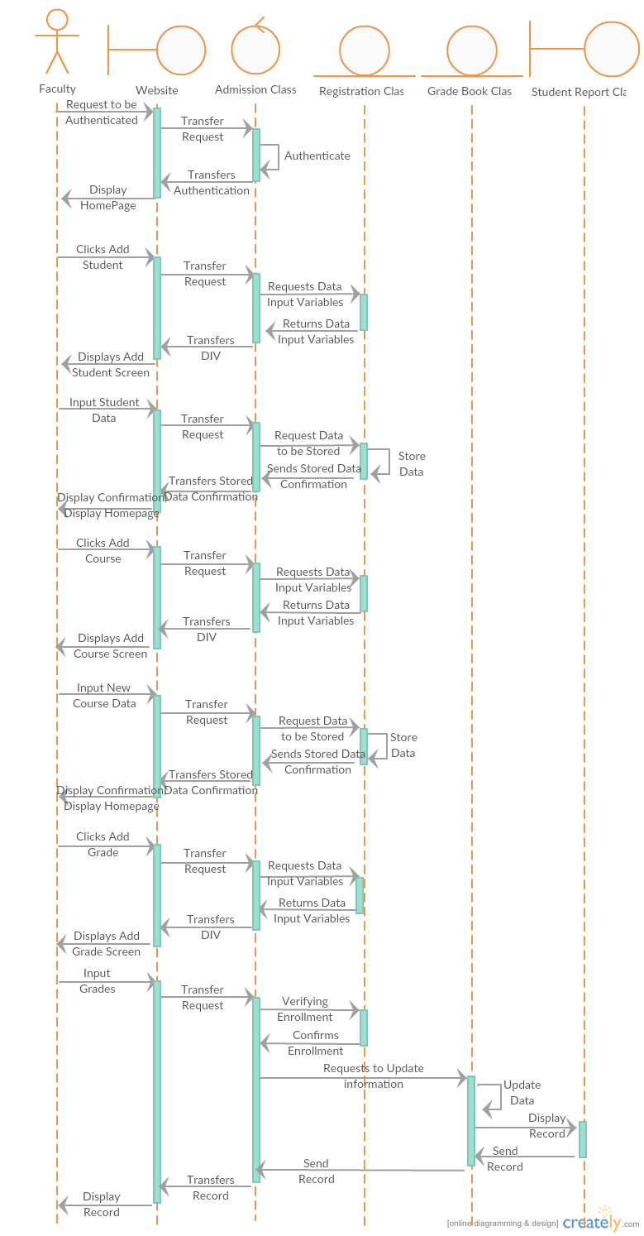
Sequence diagram

Slide 5
Git hub version control
https://github.com/CruzBL/SE-Project-

Slide 6
The end

